Slide 1
Shannon Capacity
Defined as the maximum MI of channel
Maximum error-free data rate a channel can support.
Theoretical limit (not achievable)
Channel characteristic
  Not dependent on design techniques

Slide 2



Capacity in AWGN
Mutual information based capacity
Capacity of AWGN channel (Shannon fomula)
SNR

Slide 3
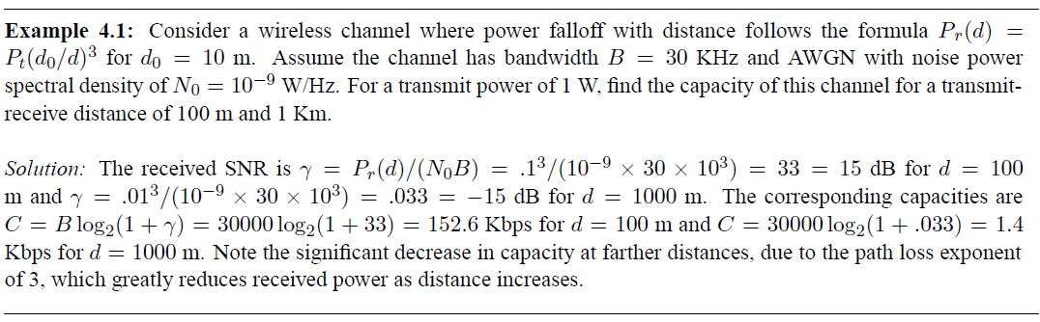
Capacity in AWGN: Example

Slide 4
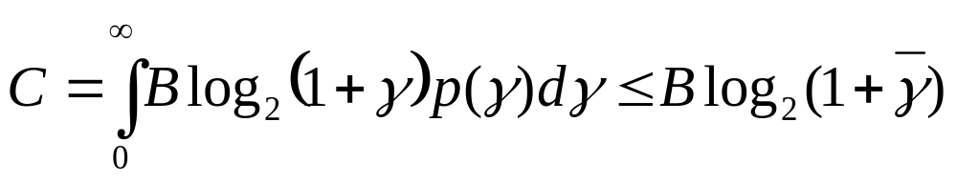
Capacity of Flat-Fading Channels
Capacity defines theoretical rate limit
  Maximum error free rate a channel can support
Depends on what is known about channel
Fading Statistics Known
  Hard to find capacity
Fading Known at Receiver Only

Slide 5
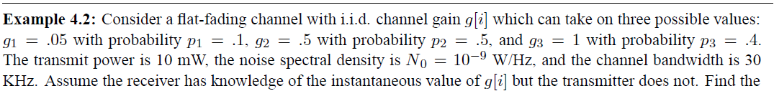
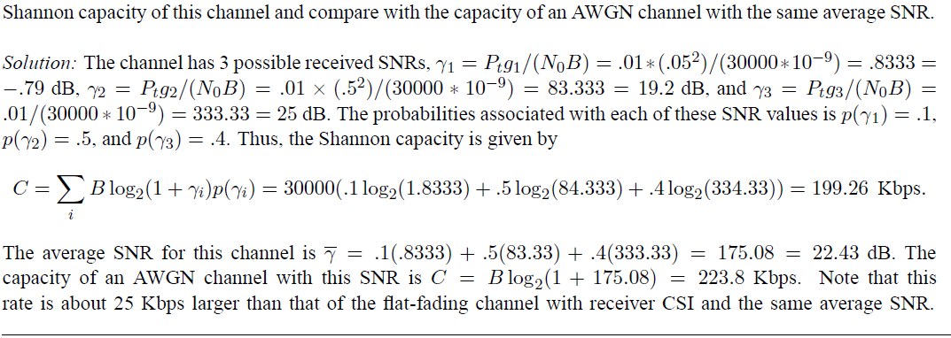
Flat-Fading Channels: Example

Slide 6
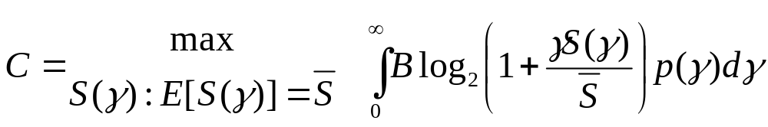
Fading Known at
Transmitter and Receiver
For fixed transmit power, same as with only receiver knowledge of fading
Transmit power S(γ) can also be adapted
Leads to optimization problem

Slide 7

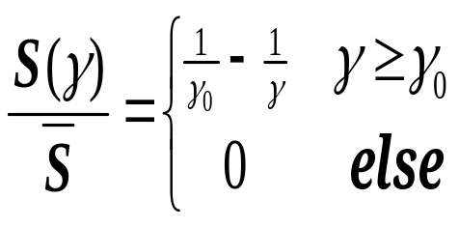
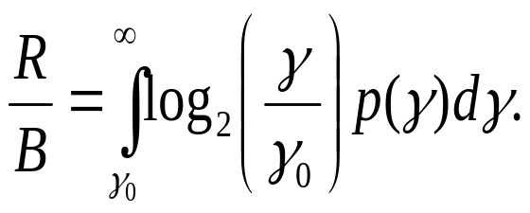
Optimal Adaptive Scheme
Waterfilling
Power Adaptation
Capacity
1
γ
γ₀
γ

Slide 8
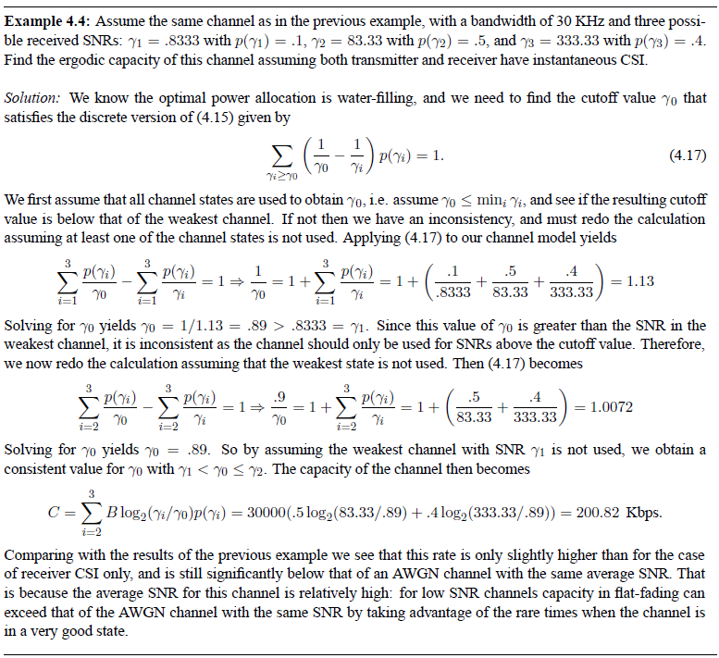
Water-Filling Example

Slide 9
Channel Inversion
Fading inverted to maintain constant SNR
Simplifies design (fixed rate)
Greatly reduces capacity
  Capacity is zero in Rayleigh fading
Truncated inversion
  Invert channel above cutoff fade depth
  Constant SNR (fixed rate) above cutoff
  Cutoff greatly increases capacity
    Close to optimal

Slide 10
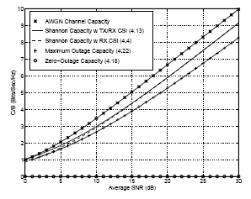
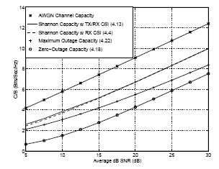
Capacity Comparison
Rayleigh
Log-Normal

Slide 11
Frequency Selective
Fading Channels
For TI channels, capacity achieved by water-filling in frequency
Capacity of time-varying channel unknown
Approximate by dividing into subbands
  Each subband has width B_{c} (like MCM).
  Independent fading in each subband
  Capacity is the sum of subband capacities
1/|H(f)|²
P
B_{c}
f

Slide 12
Main Points
Fundamental capacity of flat-fading channels depends on what is known at TX and RX.
  Capacity when only RX knows fading same as when TX and RX know fading but power fixed.
  Capacity with TX/RX knowledge: variable-rate variable-power transmission (water filling) optimal
  Almost same capacity as with RX knowledge only
  Channel inversion practical, but should truncate
Capacity of wideband channel obtained by breaking up channel into subbands
  Similar to multicarrier modulation

